Slide 1
EA SPORTS FC 25 | DATA CHALLENGE
PLAYER PERFORMANCE,
VALUATION & WAGE ANALYSIS
An interactive analysis of male player records across FIFA editions 15–24
FOCUS AREAS
PERFORMANCE
FINANCIALS
Ratings • Potential • Player profiles
Edition history • Rating progression
Market value • Player wages
Prepared by Isah Joshua

Slide 2
PROJECT OVERVIEW
Scope, dataset and analytical questions
DATASET
QUESTIONS EXPLORED
ANALYTICAL OUTPUT
180,021 player-edition records
53,111 unique player IDs
109 original source columns
FIFA editions 15–24
How do player ratings vary by edition?
How are players distributed by position, club and nationality?
How do value and wages vary?
Four-page Power BI dashboard
KPI measures and interactive slicers
Player-level edition history
Market value and wage comparisons
Record definition: one row represents one player in one FIFA edition. A player can therefore appear in multiple editions; player records and unique players are different measures.
Source: uploaded male_players.csv supplied for this project. Scope in this presentation is the male_players dataset.
2

Slide 3
DATA PREPARATION & METHOD
How the source data was prepared and analysed
1 SELECT FIELDS
2 QUALITY CHECKS
3 DERIVED FIELDS
Dashboard fields include player ID, FIFA edition, name, positions, age, overall, potential, club, nationality, value and wage.
Checked missing values and duplicate player-edition pairs. No duplicate player_id + fifa_version pairs were found.
Primary Position uses the first-listed position. Player Edition Detail counts distinct FIFA editions per player ID.
Measures include total player records, distinct players, average overall, average potential, potential gap, average age, average market value, maximum market value, average wage and maximum wage.
Data handling note: blank market value, wage and club fields remain missing; they are not treated as zero. Averages exclude missing numeric values.
3

Slide 4
KEY PERFORMANCE INDICATORS
Full-dataset descriptive statistics
180,021
53,111
65.71
70.78
Player records
Unique players
Average overall
Average potential
5.07
25.14
€2.38M
€10,638
Average potential gap
Average age
Average market value
Average wage
Potential gap is the difference between average potential and average overall rating; it is descriptive, not a forecast of future player improvement.
4

Slide 5
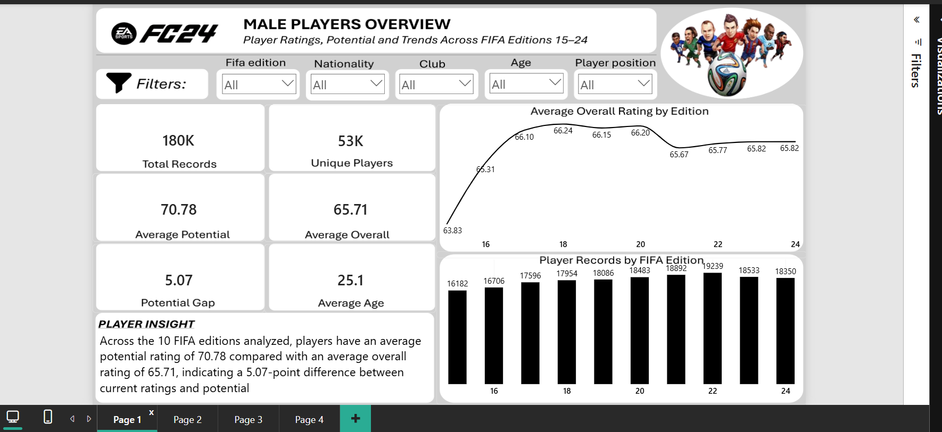
PAGE 1 | MALE PLAYERS OVERVIEW
Player ratings, potential and trends across FIFA editions 15–24
WHAT THIS PAGE COVERS
Six KPI cards summarise records, unique players, average overall, average potential, potential gap and age.
Charts show average overall rating and player-record volume by FIFA edition.
Slicers support edition, nationality, club, age and player position exploration.
5

Slide 6
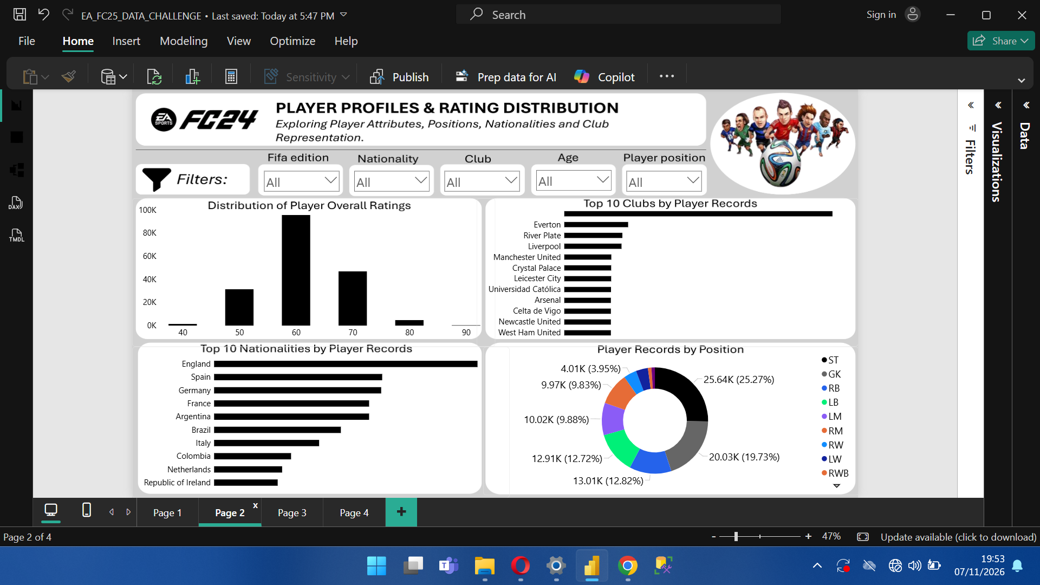
PAGE 2 | PLAYER PROFILES & RATING DISTRIBUTION
Exploring player attributes, positions, nationalities and club representation
WHAT THIS PAGE COVERS
Rating bands show the distribution of player overall ratings.
Additional visuals compare player records by primary position and rank the leading nationalities and clubs.
Primary Position is the first-listed position in the source field.
6

Slide 7
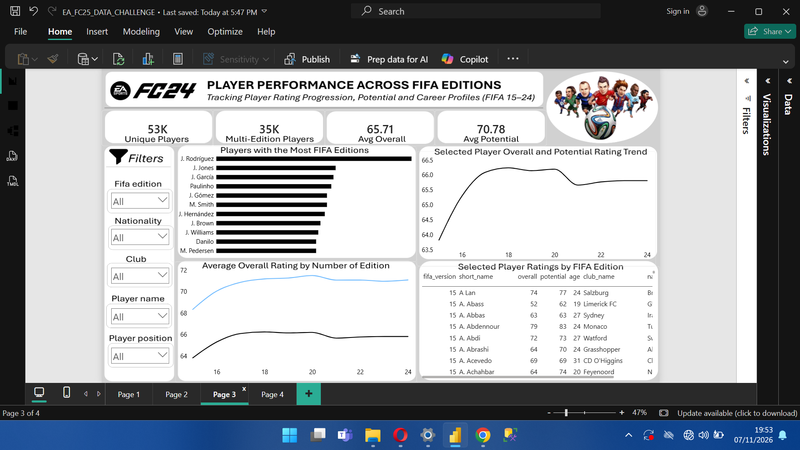
PAGE 3 | PLAYER PERFORMANCE ACROSS FIFA EDITIONS
Tracking player rating progression, potential and career profiles
WHAT THIS PAGE COVERS
Player Edition Detail ranks players by the number of distinct FIFA editions in which they appear.
A selected-player line chart follows overall rating across editions. Another chart compares average overall and potential. The table provides player-level edition history.
7

Slide 8
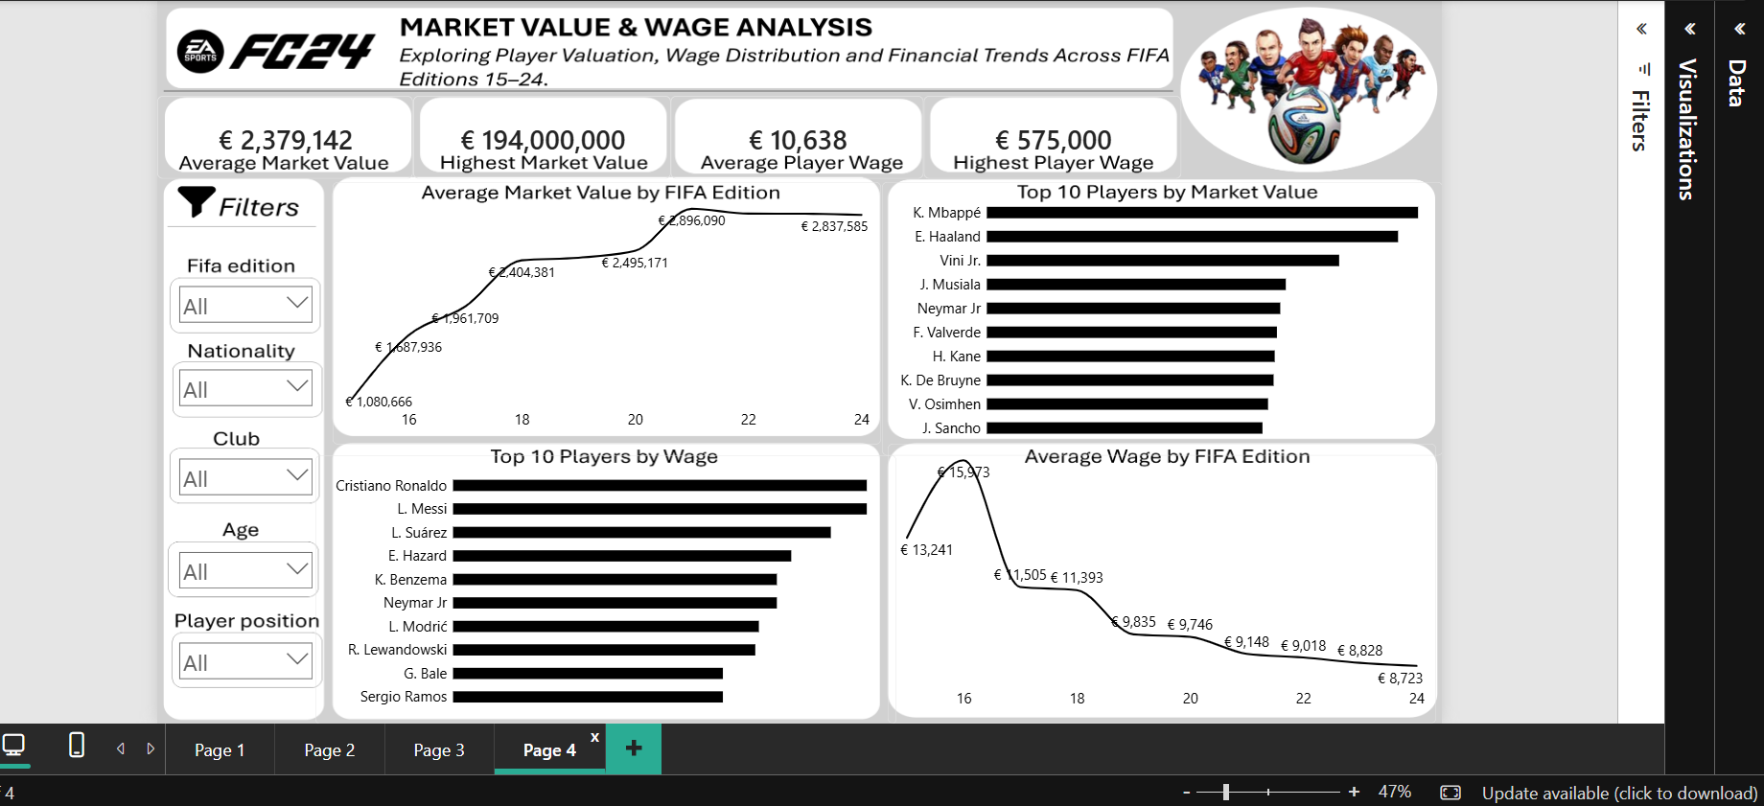
PAGE 4 | MARKET VALUE & WAGE ANALYSIS
Exploring player valuation, wage distribution and financial trends
WHAT THIS PAGE COVERS
Four KPI cards show average and maximum market value and wages.
Line charts compare average market value and average wage by edition. Bar charts rank the top ten players by value and wage.
Values are dataset fields in EUR, not verified real-world transfer fees or salaries.
8

Slide 9
KEY FINDINGS & INTERPRETATION
What the descriptive analysis indicates
RATINGS & POTENTIAL
PLAYER HISTORY
Average potential (70.78) is 5.07 points above average overall rating (65.71) across the full dataset.
The dataset contains 53,111 unique player IDs across 180,021 player-edition records. Many players appear in more than one edition.
MARKET VALUE & WAGES
LIMITATIONS
Average market value is €2,379,142; average wage is €10,638. Maximum values are €194,000,000 and €575,000 respectively.
FIFA dataset values are not necessarily actual market transactions or payroll records. Missing fields and dataset coverage affect interpretation.
Findings are descriptive and should be interpreted within the supplied dataset's scope.
9

Slide 10
CONCLUSION
A four-page interactive view of player ratings,
profiles, edition history and financial attributes.
The project demonstrates data preparation, descriptive analysis, DAX measures and dashboard storytelling using the male player dataset.
Thank you for reviewing my submission.
EA FC25 Data Challenge

